Slide 1
AIRPLANE Crash Analysis
Using PowerBI

Slide 2
PROBLEM STATEMENT
The goal is to leverage Power BI for interactive visualizations and in-depth insights to understand patterns, contributing factors, and trends in aviation incidents. The analysis aims to provide stakeholders with valuable information for enhancing aviation safety and mitigating risks.

Slide 3
DATA DESCRIPTION
Date: Date of the airplane crash.
Time: Time of the airplane crash.
Location: Location where the airplane crash occurred.
Operator: Operator or airline involved in the incident.
Flight #: Flight number associated with the incident.
Route: Planned route of the flight.
AC Type: Aircraft type involved in the crash.
Registration: Registration details of the aircraft.
cn/ln: Construction or serial number of the aircraft.
Aboard: Total number of individuals aboard the aircraft.
Aboard Passengers: Number of passengers aboard the aircraft.
Aboard Crew: Number of crew members aboard the aircraft.
Fatalities: Total fatalities in the incident.
Fatalities Passengers: Number of passenger fatalities.
Fatalities Crew: Number of crew member fatalities.
Ground: Casualties on the ground, if any.
Summary: Brief summary or description of the incident.

Slide 4
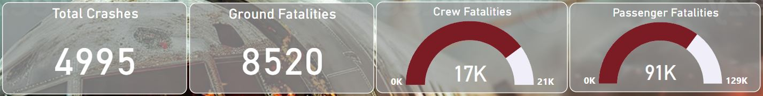
Key insights
Dataset spans from 1908 to 2023.
Records a total of 4,995 crashes.
There have been 8,520 fatalities on the ground.
Out of 129,000 passengers aboard, there were 91,000 fatalities.
Out of 21,000 crew members aboard, there were 17,000 fatalities.

Slide 5
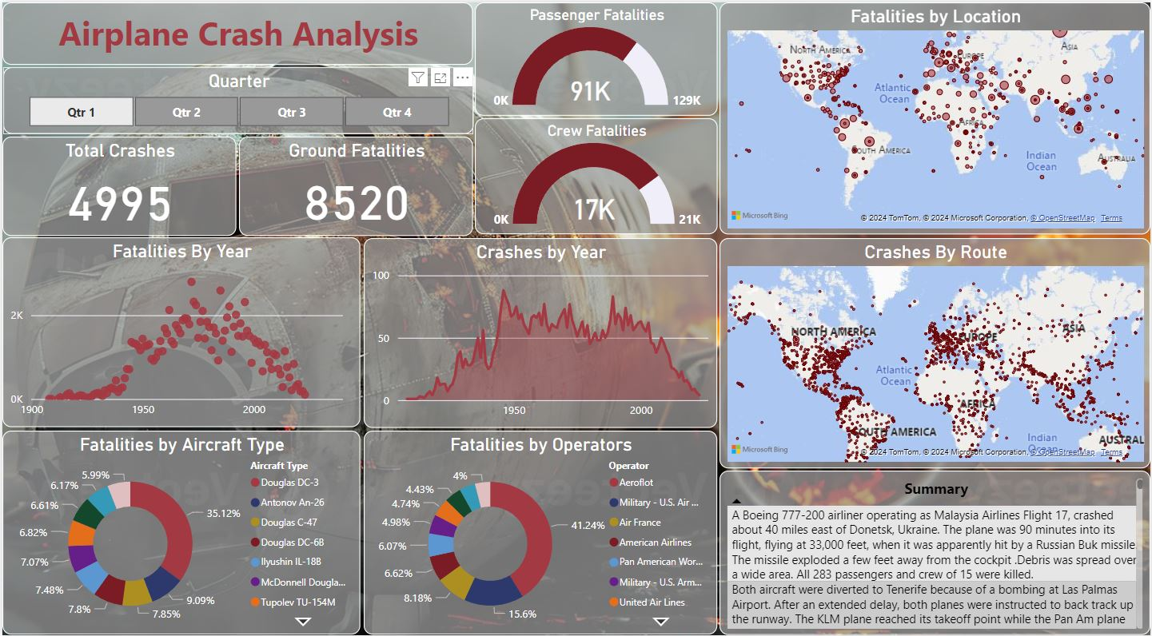
Dashboard

Slide 6
Project Objectives:
Temporal Analysis:
- Explore temporal trends in airplane crashes over the years.
- Identify patterns in the frequency and severity of incidents.
Geospatial Analysis:
- Visualize crash locations on a map to identify hotspots.
- Analyze the distribution of incidents across different regions.
Operator Performance:
- Evaluate the safety records of different operators and airlines.
- Identify operators with higher incident rates.
Aircraft Analysis:
- Analyze the involvement of specific aircraft types in incidents.
- Examine the relationship between aircraft registration and crash occurrences.
Fatality Trends:
- Explore trends in passenger and crew fatalities.
- Investigate factors contributing to fatalities.
Route Analysis:
- Analyze incident patterns on specific flight routes.
- Identify routes with a higher likelihood of incidents.

Slide 7
01
TEMPORAL ANALYSIS

Slide 8
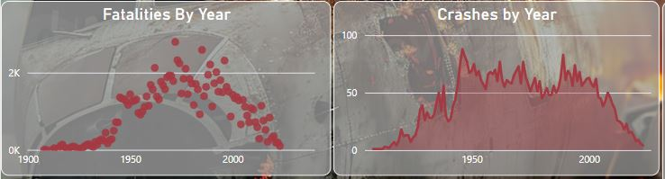
Temporal Analysis:
According to the Area Chart the analysis of airplane crashes over time shows a decline in incidents and fatalities, thanks to technological advancements, stricter safety measures, and better pilot training.
Despite the decrease in crashes, human error and mechanical failures remain significant concerns.
This analysis shows the importance of continuous improvement in safety protocols to further reduce aviation risks.

Slide 9
02
GEOSPATIAL ANALYSIS

Slide 10
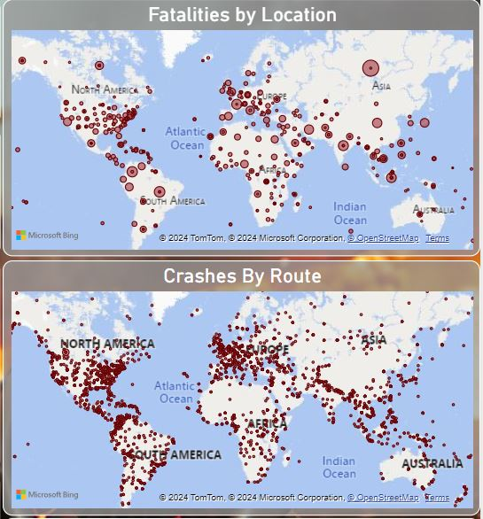
Geospatial Analysis:
Various geographical regions have been identified as having a higher incidence rate of aviation accidents with Russian region having the max fatalities
The frequency of these events varies across different areas, potentially affected by factors including air traffic density, terrain characteristics, and dominant weather conditions.

Slide 11
03
Operator performance

Slide 12
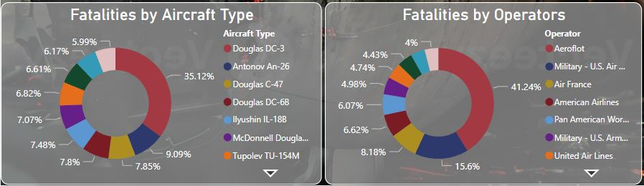
Operator Performance:
The below donut chart shows the Top 10 percentage of fatalities based on operator error:
Safety records vary significantly among operators, with some showing high incident rates, indicating a need for improved safety protocols.
2. Operators from Aeroflot have higher incident rates with a total of 255 crashes.

Slide 13
04
Aircraft Analysis

Slide 14
Aircraft Analysis:
The below donut chart shows the Top 10 percentage of fatalities based on Aircraft Type:
Analysis has revealed that specific models of aircraft have been frequently involved in incidents, suggesting the need for further investigation into these occurrences.
The Douglas DC-3 Aircraft has been in the majority of crashes according to the data with 333 crashes.

Slide 15
05
Fatality Trends

Slide 16
Fatality Trends:
The below scatter plot shows the fatality trends over the year:
There was a spike in the number of fatalities in mid 70’s with a downward trend later with less crashes due to improvement in technology and communication.
Year 1972 had the most number of fatalities of around 2796.

Slide 17
06
Route Analysis

Slide 18
Route Analysis:
The below map shows the crashes based on different routes over the year:
Some flight routes are more prone to incidents due to complex routes, weather, and traffic.
Certain parts of Europe and North America show huge number of crashes according to the map

Slide 19
Thank you

